Slide 1

Introduction to Machine Learning
DSLA Course
Rohit Padebettu

Slide 2
Machine Learning – What?
What does Machine Learning mean to you?
”Giving computers the ability to learn without being explicitly programmed.”
– Arthur Samuel

Slide 3
Machine Learning – Where?
“Anyone who stops learning is old, whether at twenty or eighty. Anyone who keeps learning stays young. The greatest thing in life is to keep your mind young.” – Henry Ford

Slide 4
Machine Learning – How?
“Prediction is difficult, especially about the future”
- Yogi Berra

Slide 5
Machine Learning – Why?
“Don’t you want to build something like this ? ”
- Yours Truly

Slide 6
Machine Learning – Linear Regression
What is a Linear Regression?
How many points necessary to draw a line?
Ex: Time vs Distance problem

Slide 7
Linear Regression – RMSE
Best Fit Line Minimizes
Root
Mean
Squared
Error

Slide 8
Instructor Case - Motor Trends
Can you predict the Mileage of a car given its Weight?
Model | mpg | cyl | disp | hp | drat | wt | qsec
Mazda RX4 | 21 | 6 | 160 | 110 | 3.9 | 2.62 | 16.46
Mazda RX4 Wag | 21 | 6 | 160 | 110 | 3.9 | 2.875 | 17.02
Datsun 710 | 22.8 | 4 | 108 | 93 | 3.85 | 2.32 | 18.61
Hornet 4 Drive | 21.4 | 6 | 258 | 110 | 3.08 | 3.215 | 19.44
Hornet Sportabout | 18.7 | 8 | 360 | 175 | 3.15 | 3.44 | 17.02

Slide 9
Instructor Case - Motor Trends
Step 1 : Arrange the data in this form
Model | mpg | wt
Mazda RX4 | 21 | 2.62
Mazda RX4 Wag | 21 | 2.875
Datsun 710 | 22.8 | 2.32
Hornet 4 Drive | 21.4 | 3.215
Hornet Sportabout | 18.7 | 3.44

Slide 10
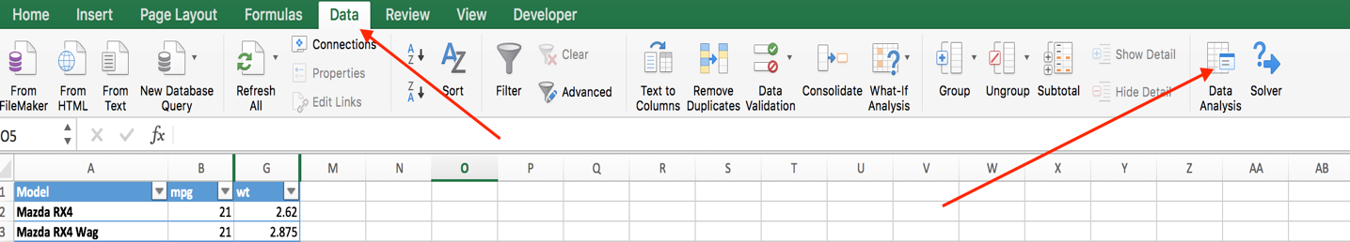
Instructor Case - Motor Trends
Step 2 : Click Data Analysis in the Data tab

Slide 11
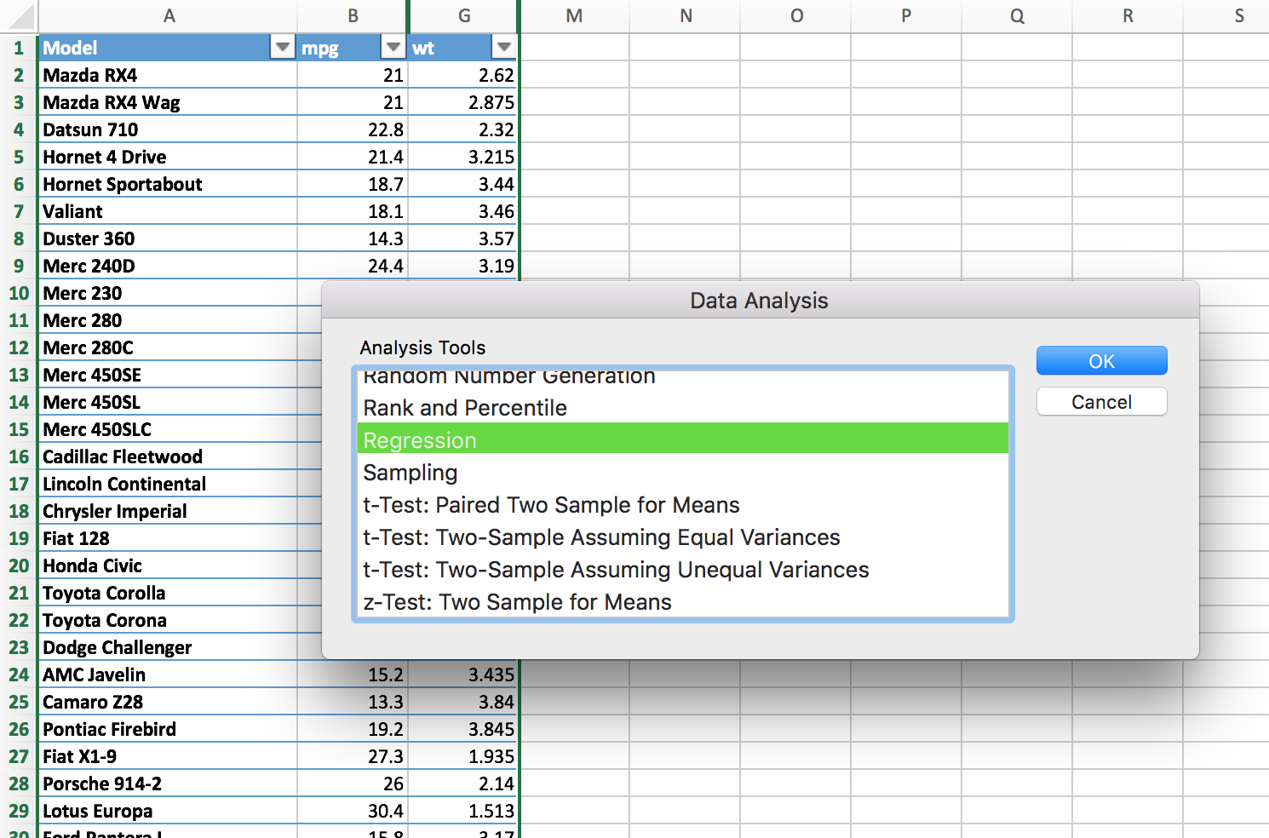
Instructor Case - Motor Trends
Step 3 : Select Regression and Click OK

Slide 12
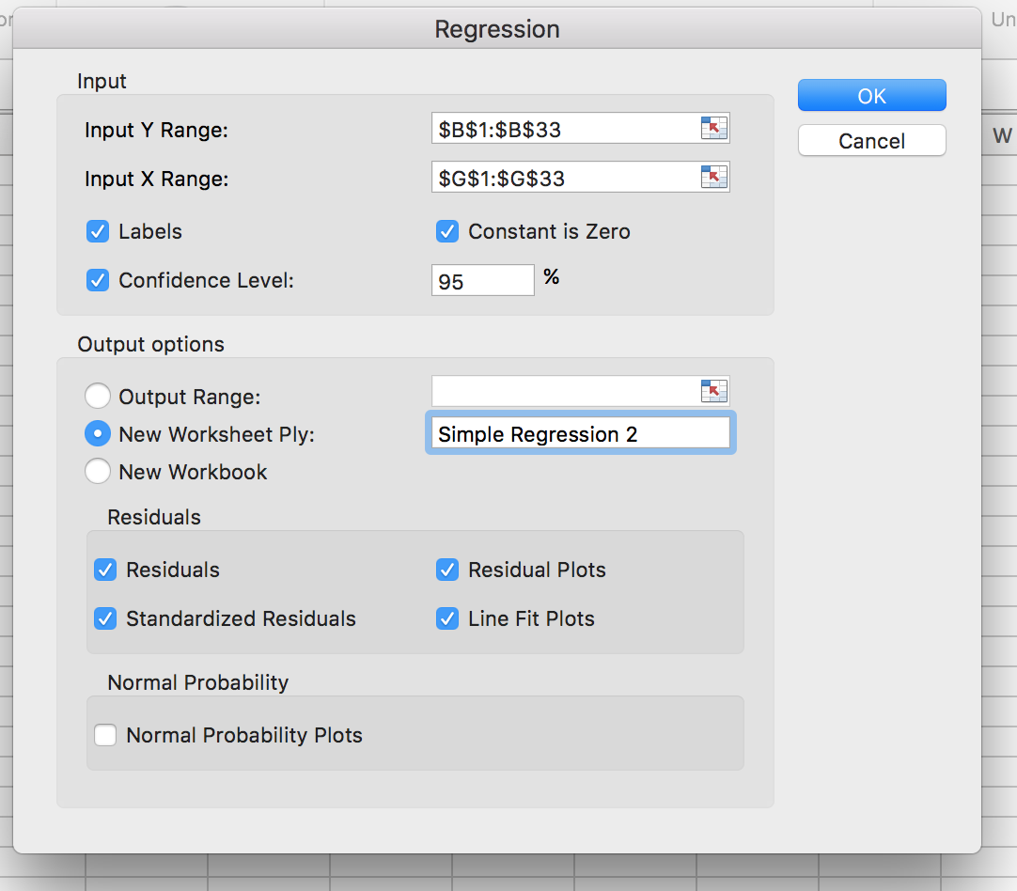
Instructor Case - Motor Trends
Step 4 : Configure Inputs and Click OK

Slide 13
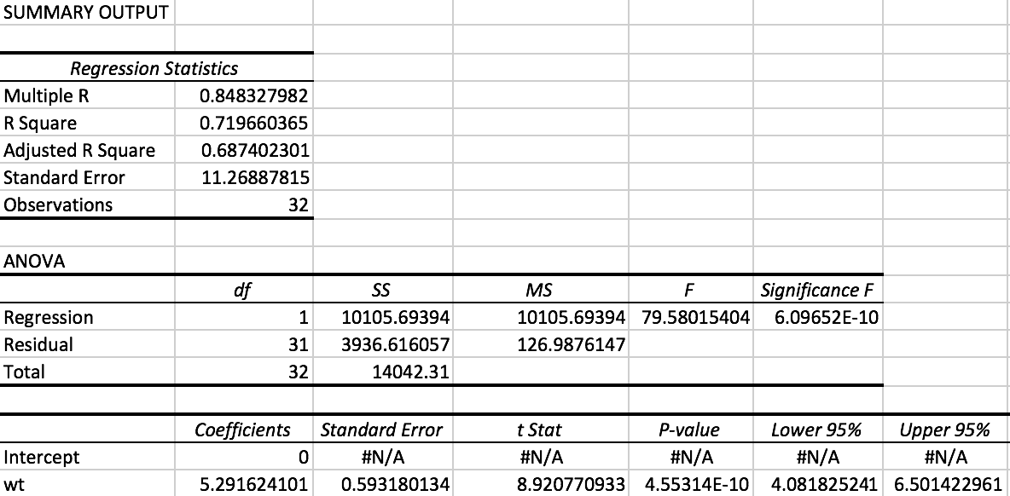
Instructor Case - Motor Trends
Step 5 : Profit!

Slide 14
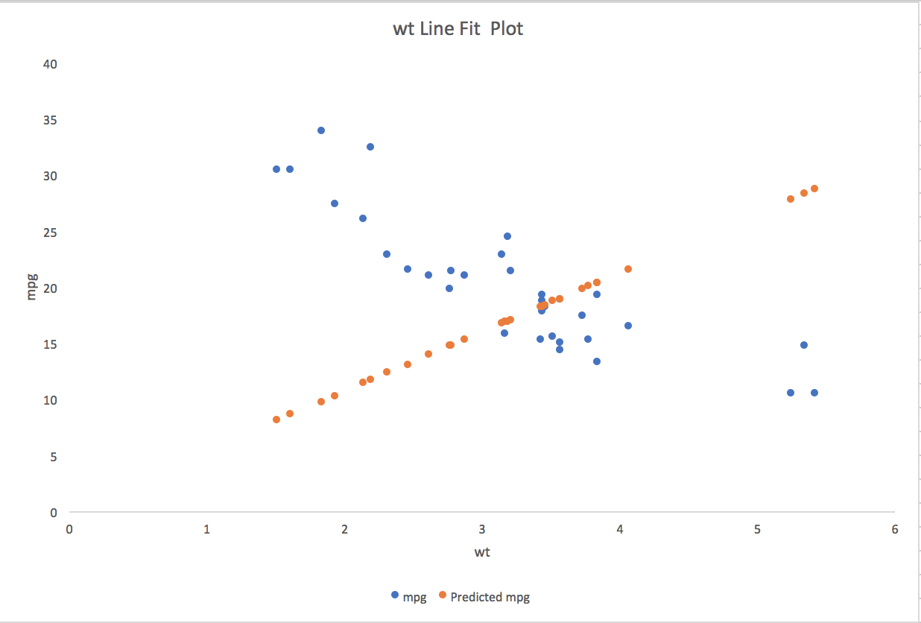
Instructor Case - Motor Trends
Step 6 : Visualize

Slide 15
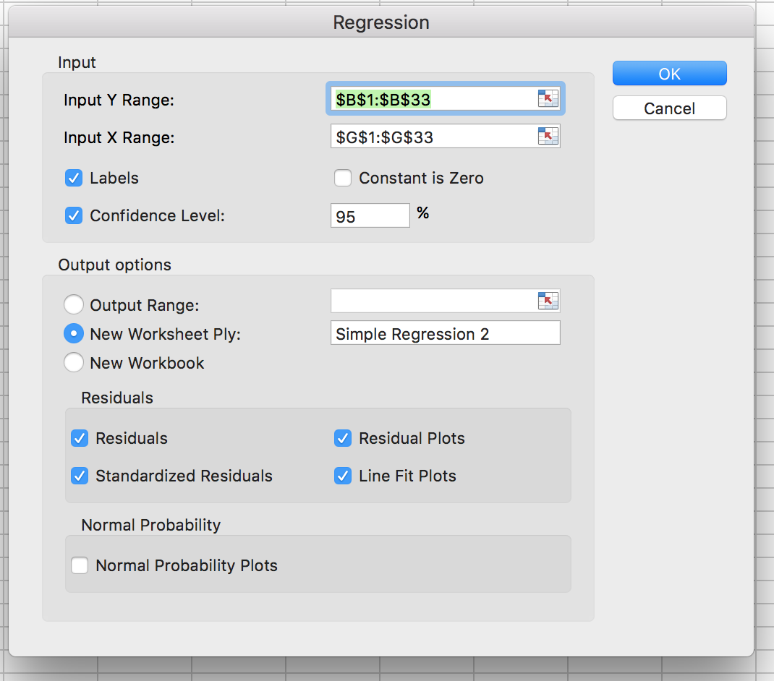
Instructor Case - Motor Trends
Step 7 : Time to make some changes!
Why did we check this ?

Slide 16
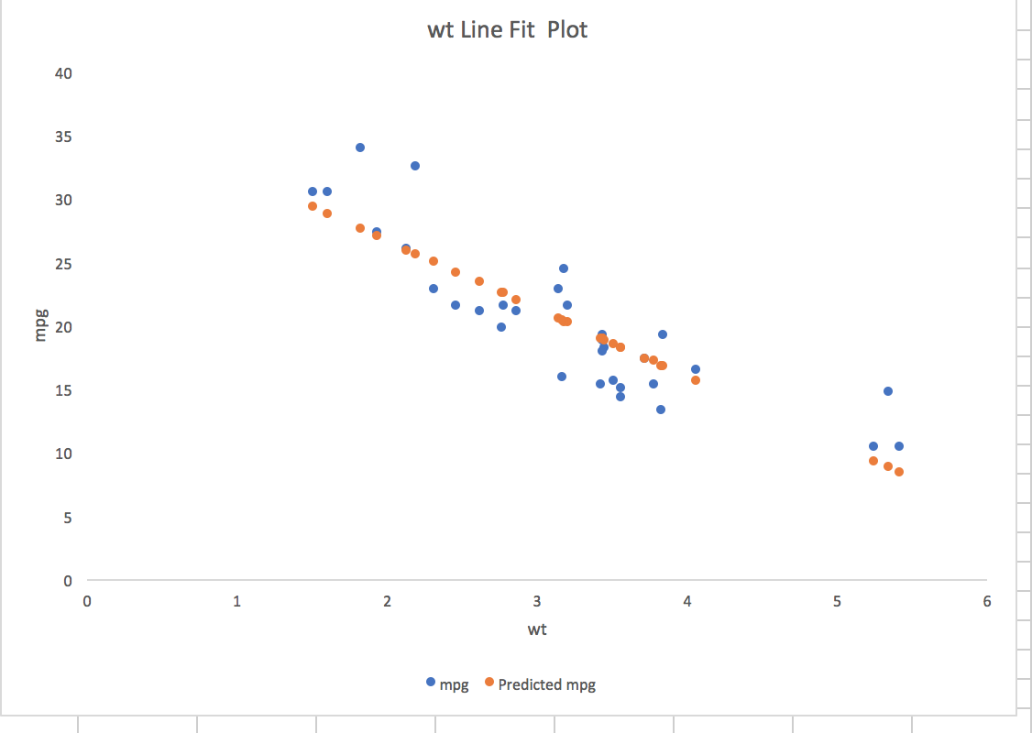
Instructor Case - Motor Trends
Step 8 : Visualize Again !

Slide 17
Instructor Case - Motor Trends
Conclusion
Mileage ≈ 37.28 - 5.34 * (Weight)
Gas Mileage of a car is expected to decrease if Weight of the car increases !

Slide 18
Instructor Case - Motor Trends
Moral
“ It is through science that we prove, but through intuition that we discover”
- Henri Poincare
(French Mathematician)

Slide 19
Machine Learning

